Slide 1
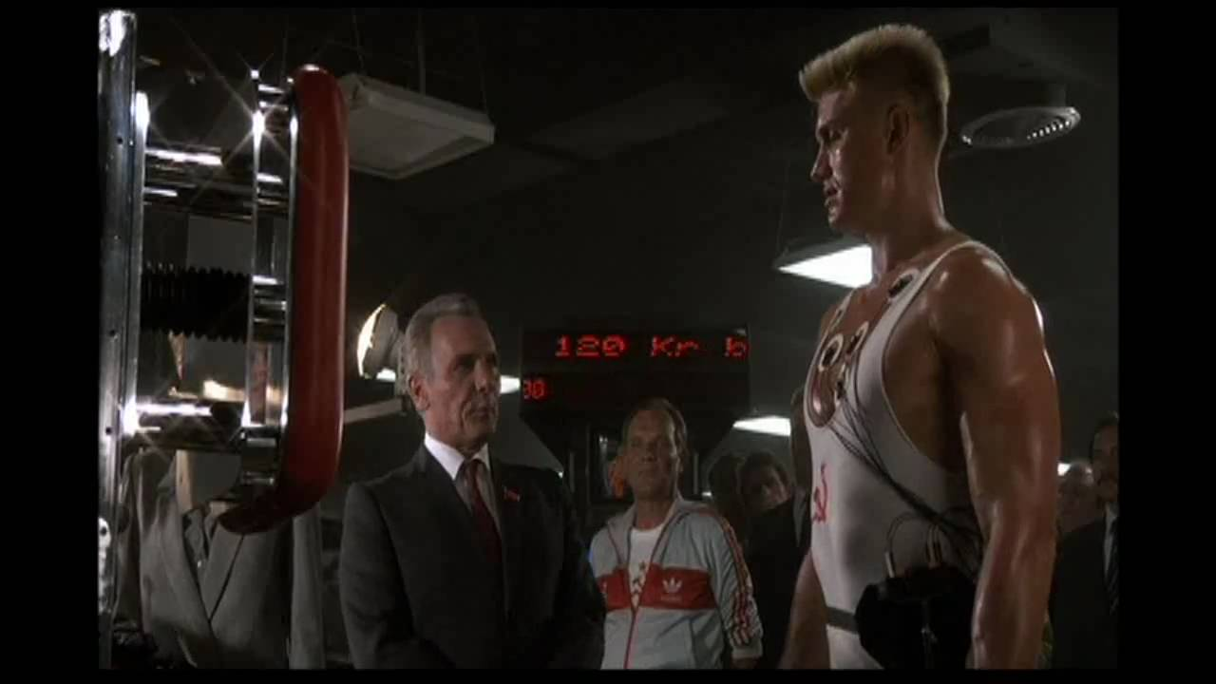
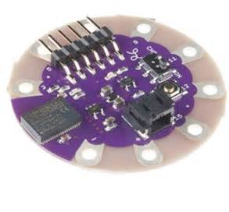
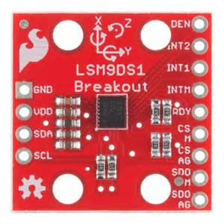
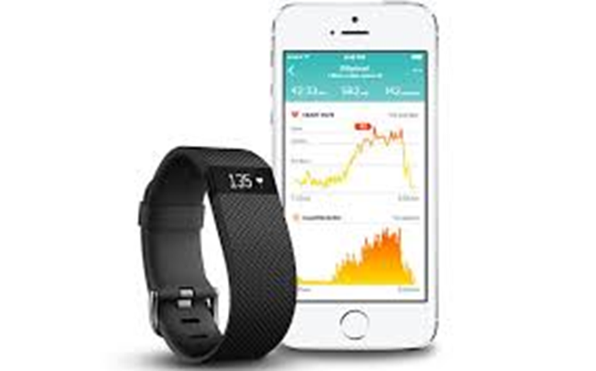
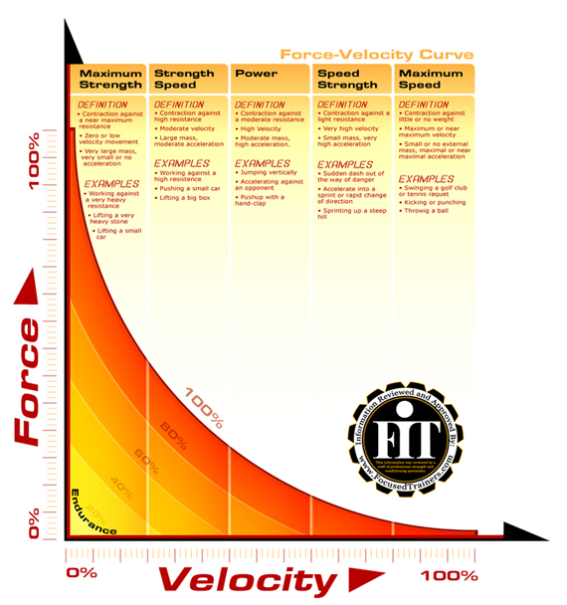
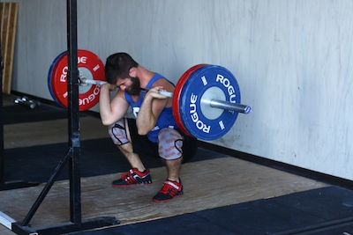
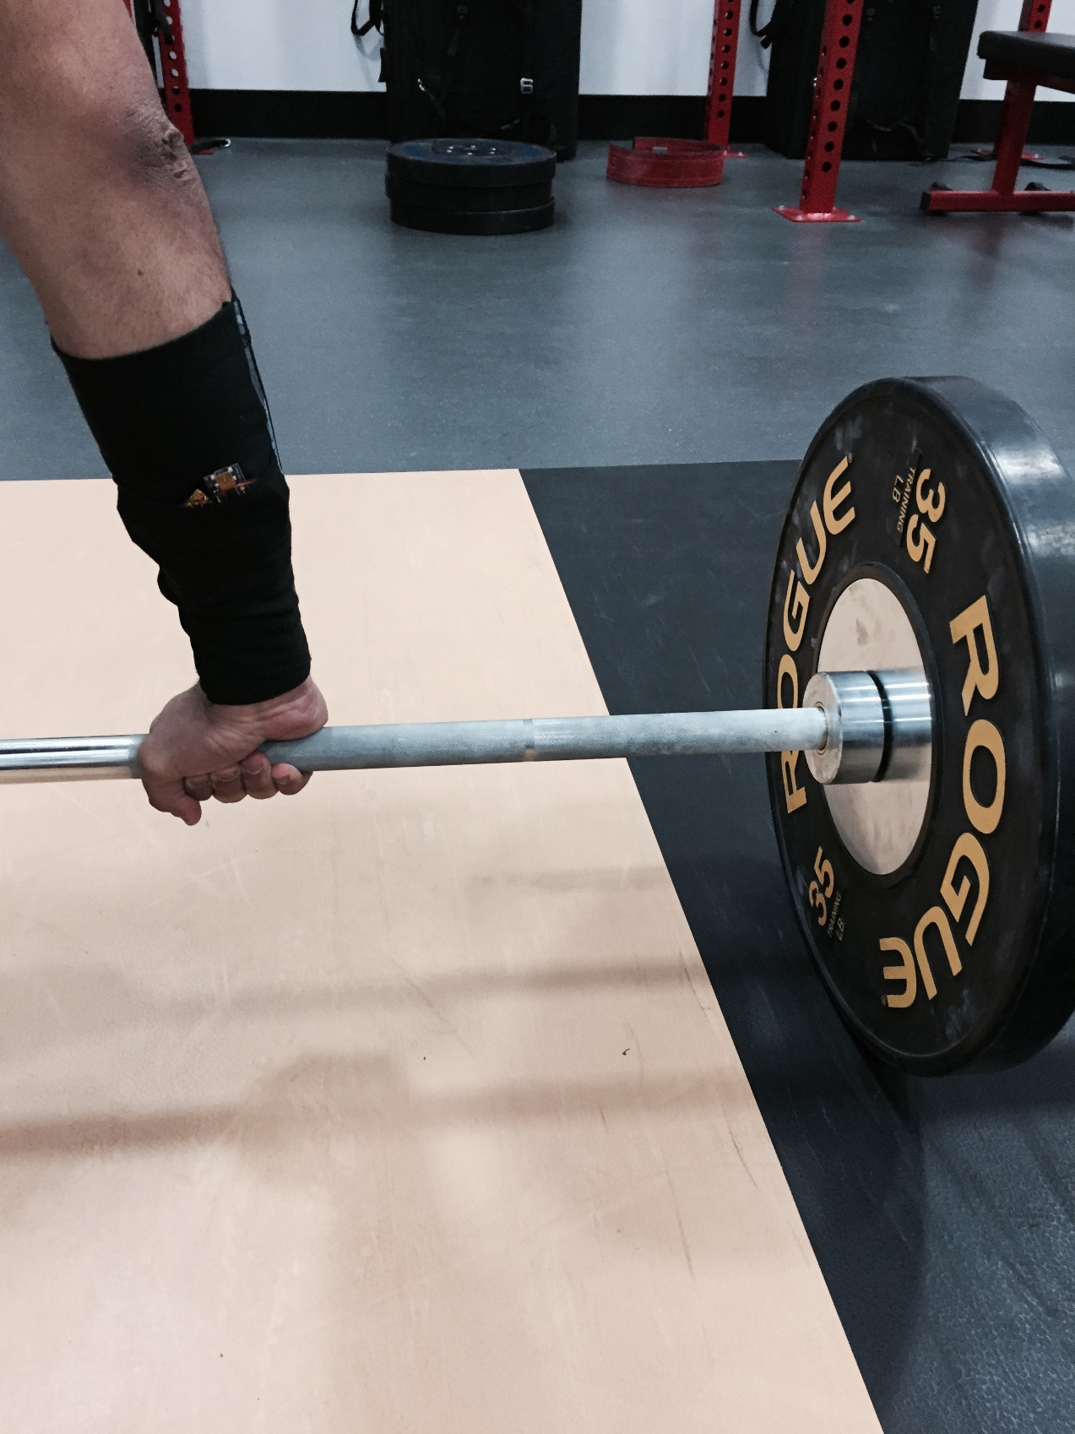
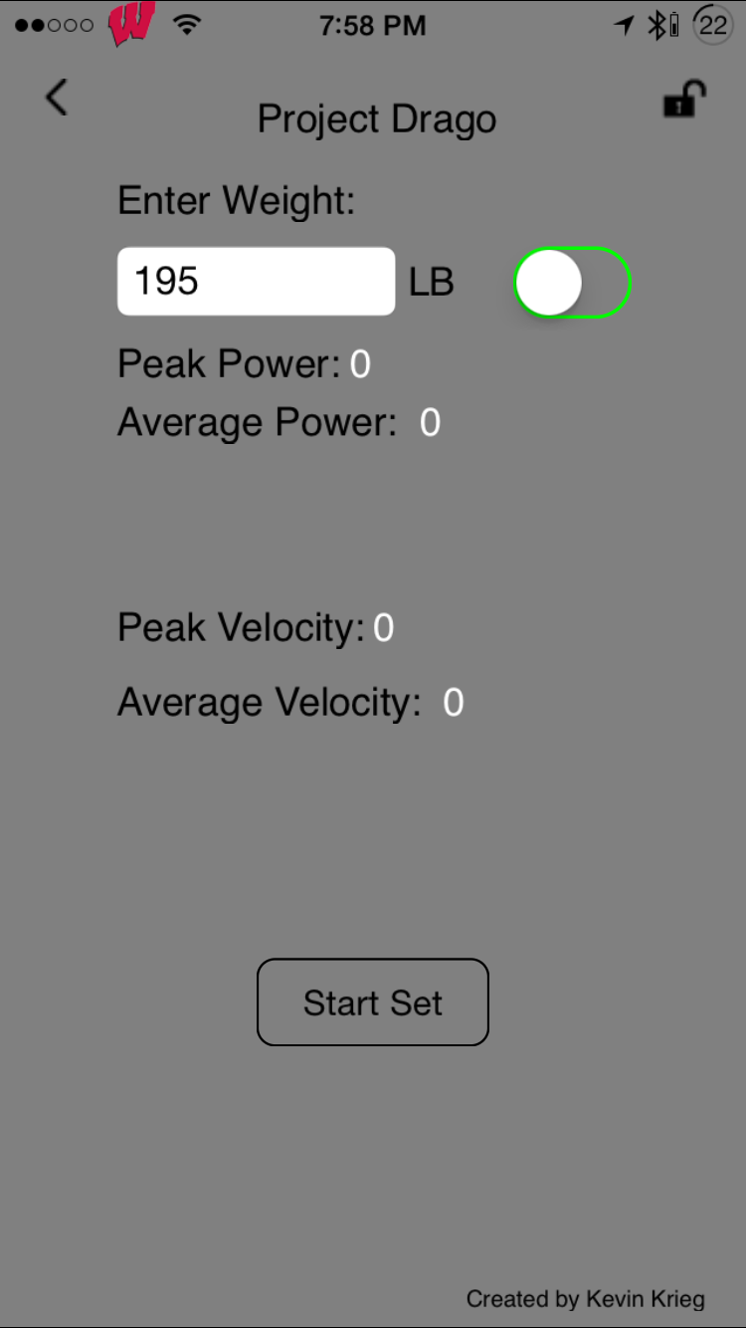
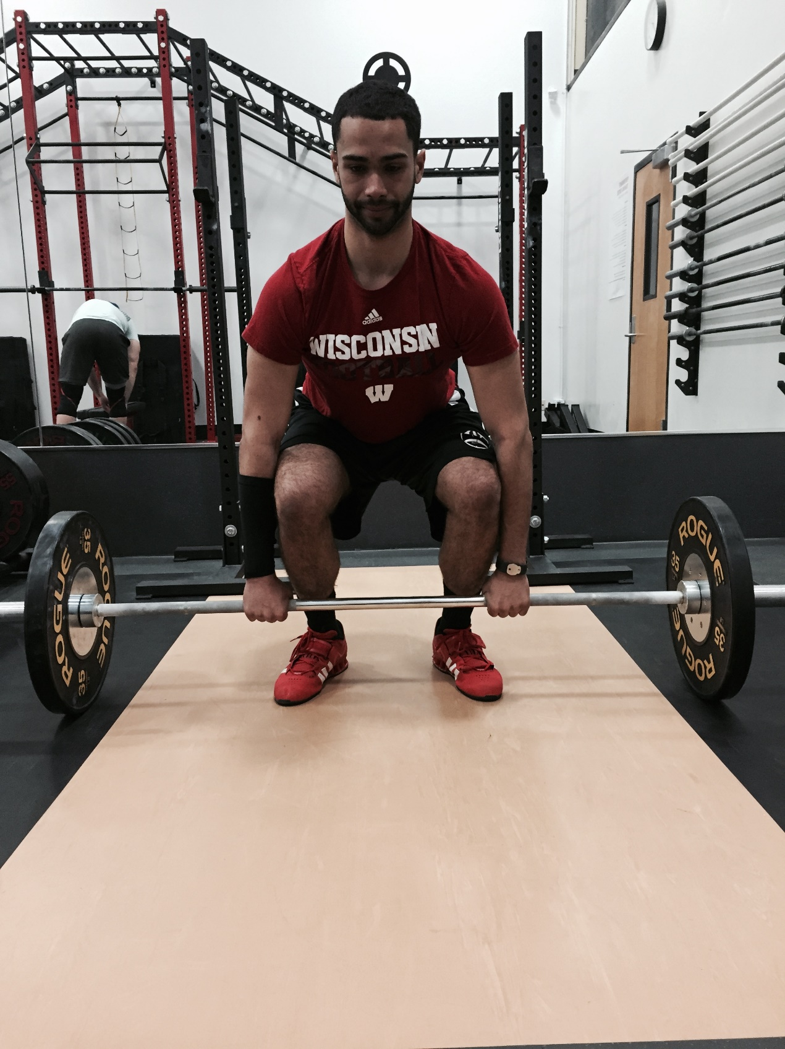
Project Drago – A Wearable Weightlifting Tracker
V = at
F = ma
P = FV
Kevin Krieg | UW – DS501 Wearable Technology https://blogs.discovery.wisc.edu/wearable2016/category/projects/fitness/drago/
Inspiration
What is it?
Velocity Based Training
Forearm sleeve form factor
Uses IMU and microcontroller to record and process motion
Measure acceleration directly - extrapolate other variables
Display Results on phone screen
Velocity can be used as an indicator of an athlete’s fatigue
Auto regulate workouts
If weights are moving slower than normal, or a drop off in velocity is seen between sets, the athlete may have reached a ceiling of beneficial adaptions that can be made with that movement
On the other hand, noticing unusually fast moving weights can allow the athlete to take advantage of a good day, and work up to heavier weights
Power Training
Ivan Drago – Rocky IV
Fictional Soviet sports science
Movie showed Ivan’s every move and muscle twitch being tracked during training
Many sports require high rate of force production
Football / Basketball / Baseball / Track and Field / Boxing / Tennis
Power = Force x Velocity
Can be generated by increasing weight on the bar, or the speed which the weight is lifted
Sweet spot (100% on graph) where power is maximized
More weight causes too much slowing of barbell
Tracking power allows for specific training to target maximum power output
Lilypad Simblee Board
Built in Simblee Bluetooth chip
Native Arduino UI code
Flat, sewable microcontroller
Inertial Movement Unit
Gyroscope
Accelerometer
Magnetometer
9 Degrees of Freedom
Why?
Commercial fitness trackers focus on aerobic exercise
Steps / Heart Rate / Distance / Calories
Weightlifters Ignored
No metrics for resistance training
Smartwatch is also not ideal form for gym
Crackable screen
Limits mobility of wrist

